Slide 1

SENTIMENT ANALYSIS OF IMAGES
G.HARIKA 21AJ1A4204
V.SANDHYA RANI 21AJ1A4233
Y.AKASH 21AJ1A4257
K.SAI KUMAR 21AJ1A4222
BATCH NO: 04
UNDER THE ESTEEMED GUIDANCE OF
Mr. P. RAMESH BABU M.Tech
PROFESSOR
DEPARTMENT OF COMPUTER SCIENCE AND ENGINEERING AMRITA SAI INSTITUTE OF SCIENCE AND TECHNOLOGY
Paritala,Vijayawada,Andhra Pradesh(521180)

Slide 2
Sentiment Analysis of images

Slide 3
CONTENT
ABSTRACT
INTRODUCTION
OBJECTIVE OF PROJECT
IMPLEMENTATION
BLOCK DIAGRAM
PROCESS MODEL
ABOUT DATASET
TOOLS AND SOFTWARE REQUIREMENTS
DESIGN WITH UML DIAGRAMS
ALGORITHM
CODE
CONCLUSION
FUTURE SCOPE
REFERENCES

Slide 4
ABSTRACT
Sentiment Analysis of Images the task of determining the emotional content of visual media, presents significant challenges due to the subjective nature of perception, contextual understanding, and technical limitations. This paper explores the current state of research in image sentiment analysis, including approaches based on low-level feature extraction, high-level feature extraction, deep learning models, and hybrid techniques.

Slide 5
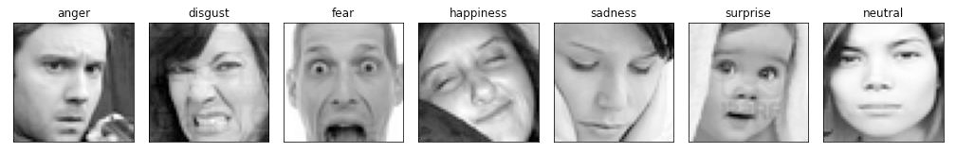
Introduction
Analyzing images sentiments allows a system to identify and acquire internal expressions using image sentiment analysis . The goal of a Visual Emotion Analysis is to identify the polarity of a given image's sentiment (positive, neutral, or negative). Positive and negative visual emotions have been categorized in two (positive and negative), three polarities as positive, neutral, and negative, or seven categories as illustrated in Figure

Slide 6
Objective of Project
The objective of sentiment analysis of an image is to automatically determine the emotional tone or attitude conveyed by the visual content. While traditional sentiment analysis is often applied to text, image sentiment analysis focuses on extracting emotions or sentiments (such as happiness, sadness, anger, fear, etc.) from visual elements in the image, such as:
Facial expressions: Recognizing human emotions through expressions.
Body language: Inferring emotional states from posture or gestures.
Context and objects: Analyzing the environment, objects, or situations depicted.
Color tones and lighting: Assessing the emotional impact of color schemes and lighting.
Scene composition: Considering how the arrangement of elements conveys a mood.

Slide 7
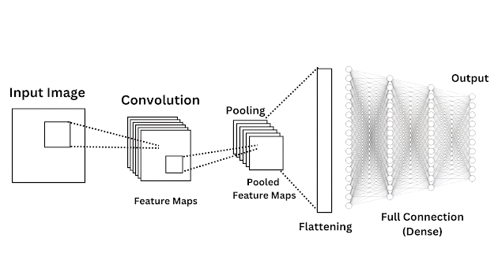
Implementation
Convolution Neural Network (CNN):
A convolutional neural network (CNN) is a type of artificial neural network used in image recognition and processing that is specifically designed to process pixel data. The convolution layers are used to help the computer determine features that could be missed in simply flattening an image into its pixel values.
Feature Extraction and Training :Feature Extraction and Training will be done using Convolution Neural Network.

Slide 8
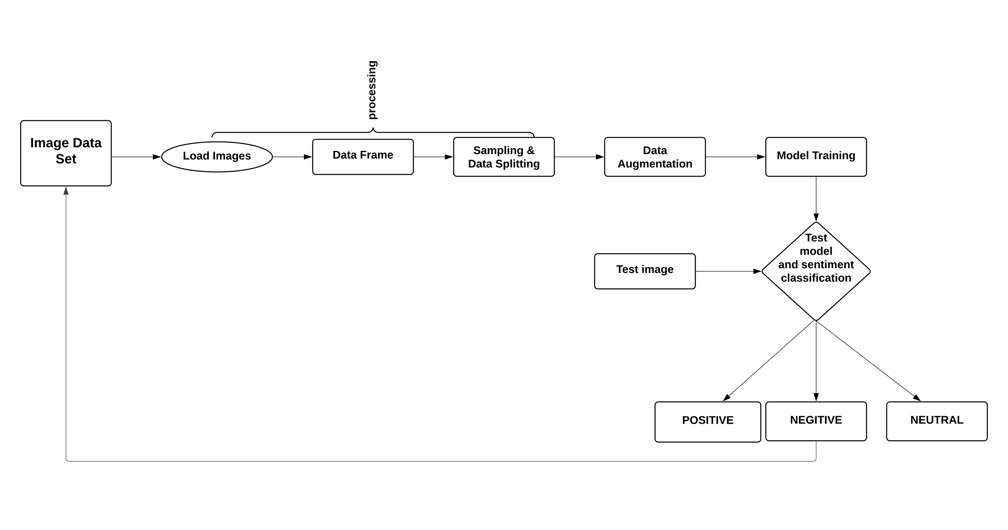
BLOCK DIAGRAM

Slide 9
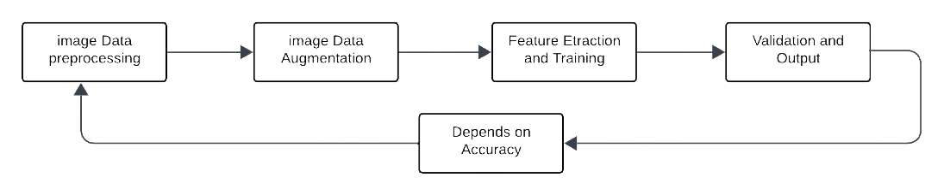
PROCESS MODEL
After selection of dataset steps in Image Expression Recognition Using CNN
1) Image Data Preprocessing
2) Image Data Augmentation
3) Feature Extraction and Training
4) Validation and Output
If not satisfied with accuracy do hyper parameter tuning by adding hidden layer,
changing learning rate, number of epochs, batch size, etc.

Slide 10
About Dataset
The data consists of 48×48 pixel grayscale images of faces. The faces have been automatically registered so that the face is more or less centred and occupies about the same amount of space in each image.The task is to categorize each face based on the emotion shown in the facial expression into one of seven categories (0=Angry, 1-Disgust, 2=Fear, 3=Happy, 4-Sad, 5=Surprise, 6-Neutral). The training set consists of 28,709 examples and the public test set consists of 3,589 examples.

Slide 11
Tools and Software Requirements
H/W SPECIFICATIONS:
Processor : I5/Intel Processor
RAM : 4GB (min)
Hard Disk : 128 GB
Key Board : Standard Windows Keyboard
Mouse : Two or Three Button Mouse
Monitor : Any
S/W SPECIFICATIONS:
Operating System : Windows 7+
Server-side Script : Python 3.6+
IDE : PyCharm , VSCode
Libraries Used : Pandas, NumPy , keras , tensarflow
Datasets : Kaggle Website
Version Controls : Git Hub
USED TECHNOLOGY:
Machine Learning And Deep Learning Algorithms
Gradio

Slide 12
DESIGN WITH UML DIAGRAMS

Slide 13
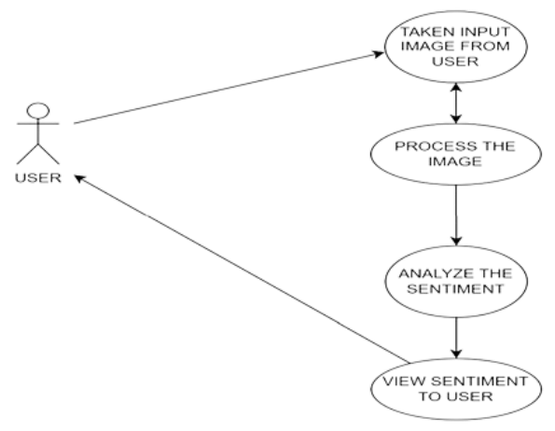
USE CASE DIAGRAM

Slide 14
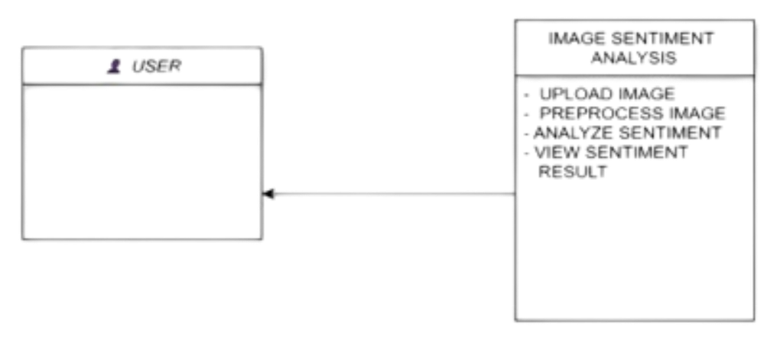
CLASS DIAGRAM

Slide 15
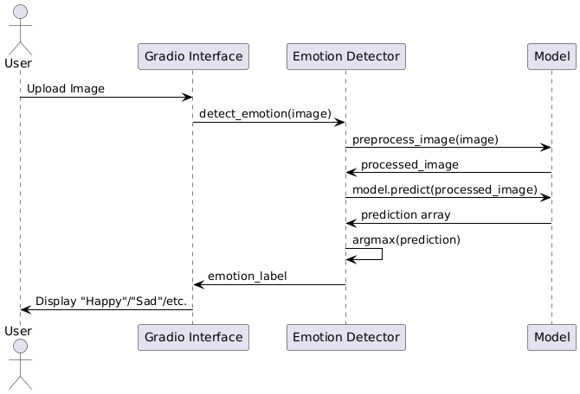
SEQUENCE DIAGRAM

Slide 16
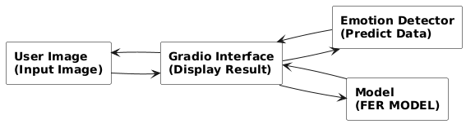
DATA FLOW DIAGRAM

Slide 17
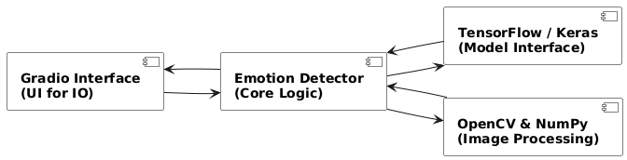
COMPONENT DIAGRAM

Slide 18
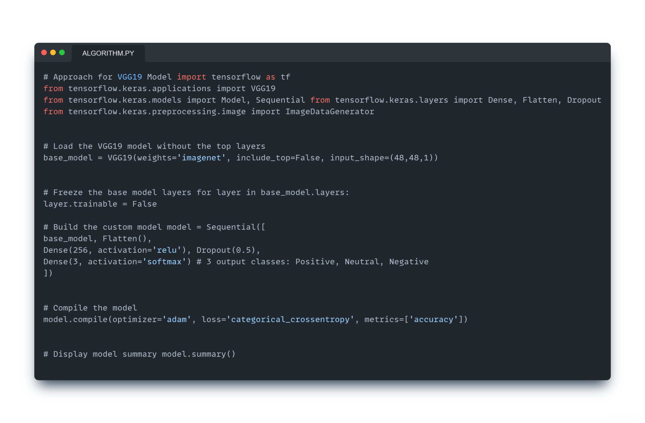
ALGORITHM

Slide 19
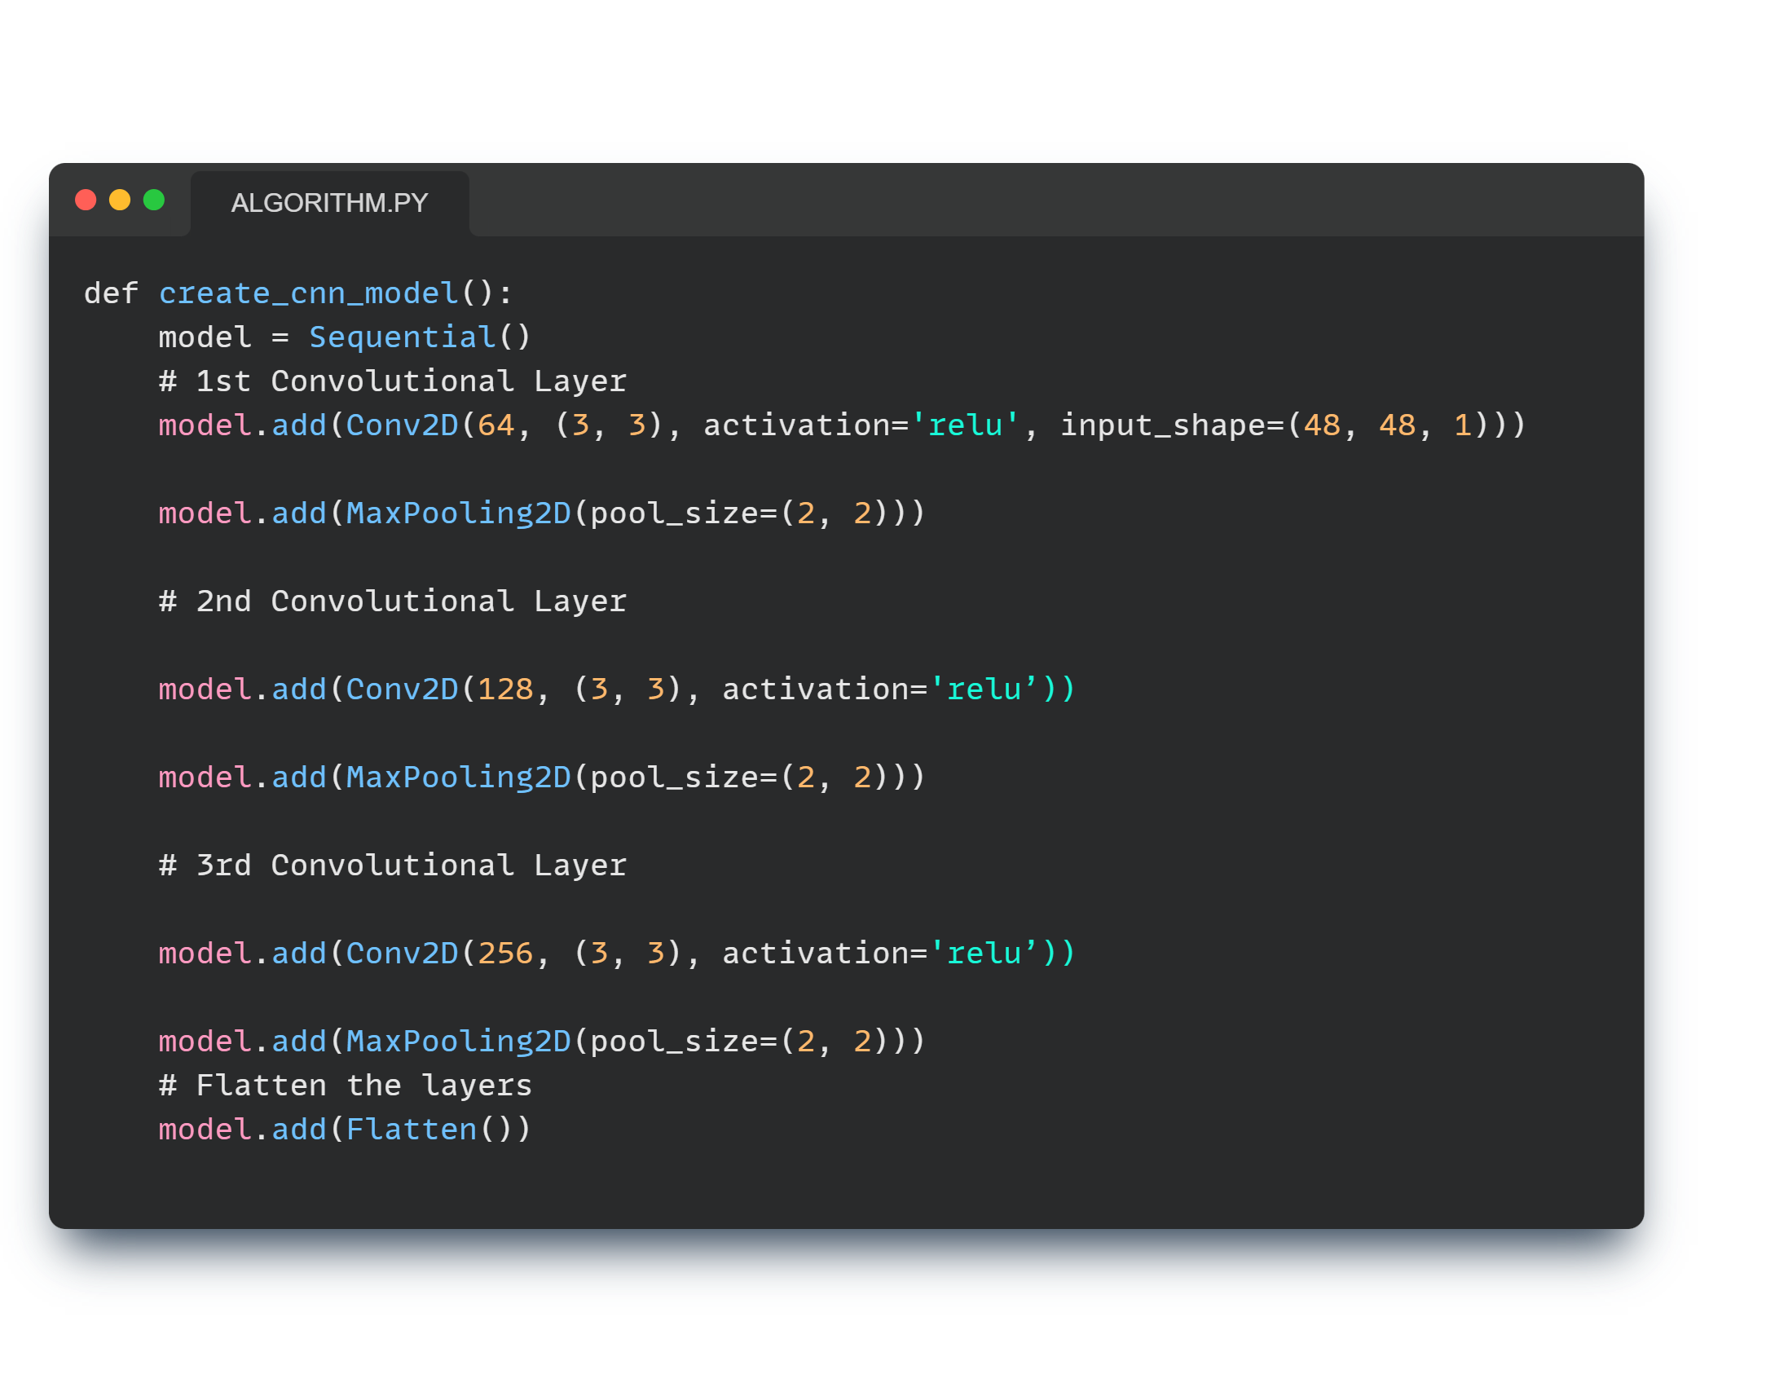
Train data and test data and applying CNN algorithm

Slide 20
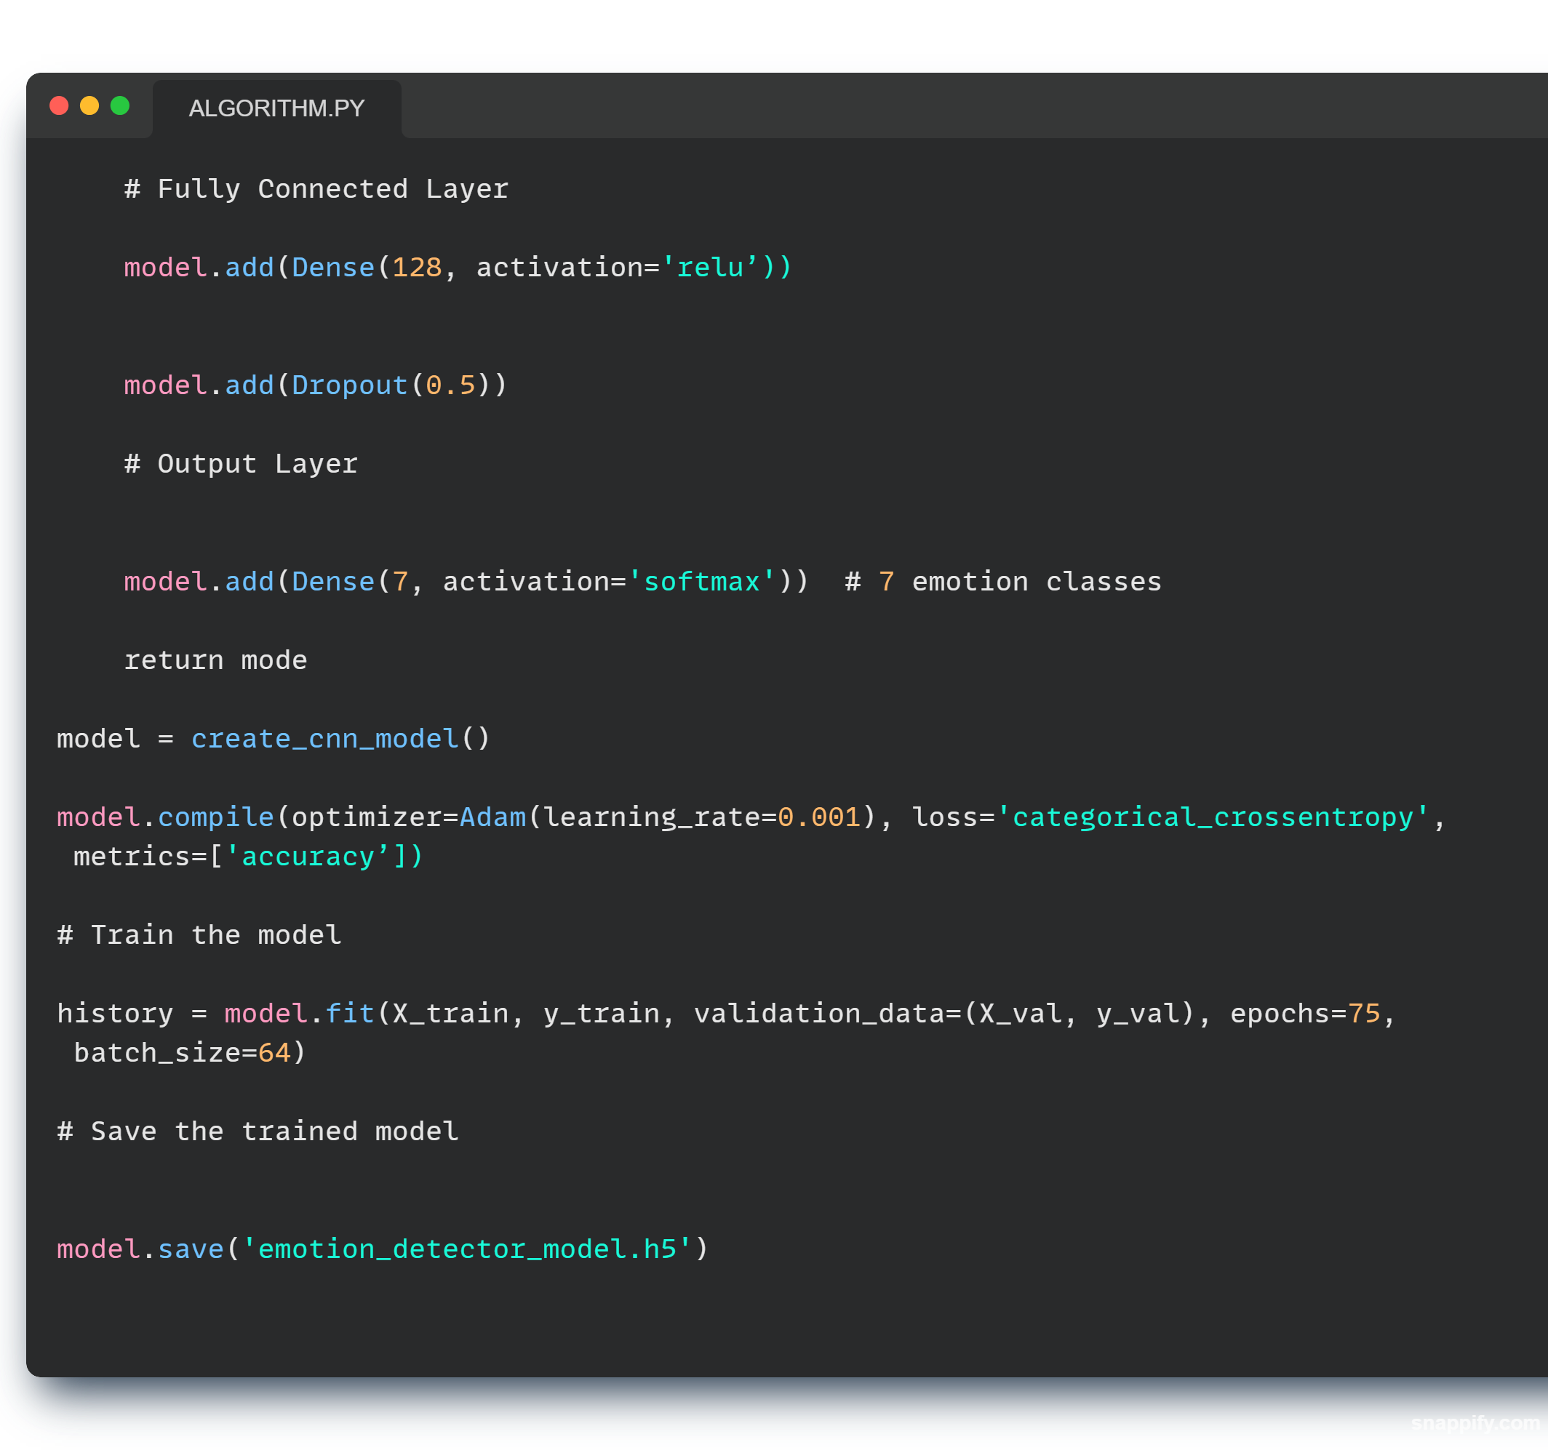

Slide 21
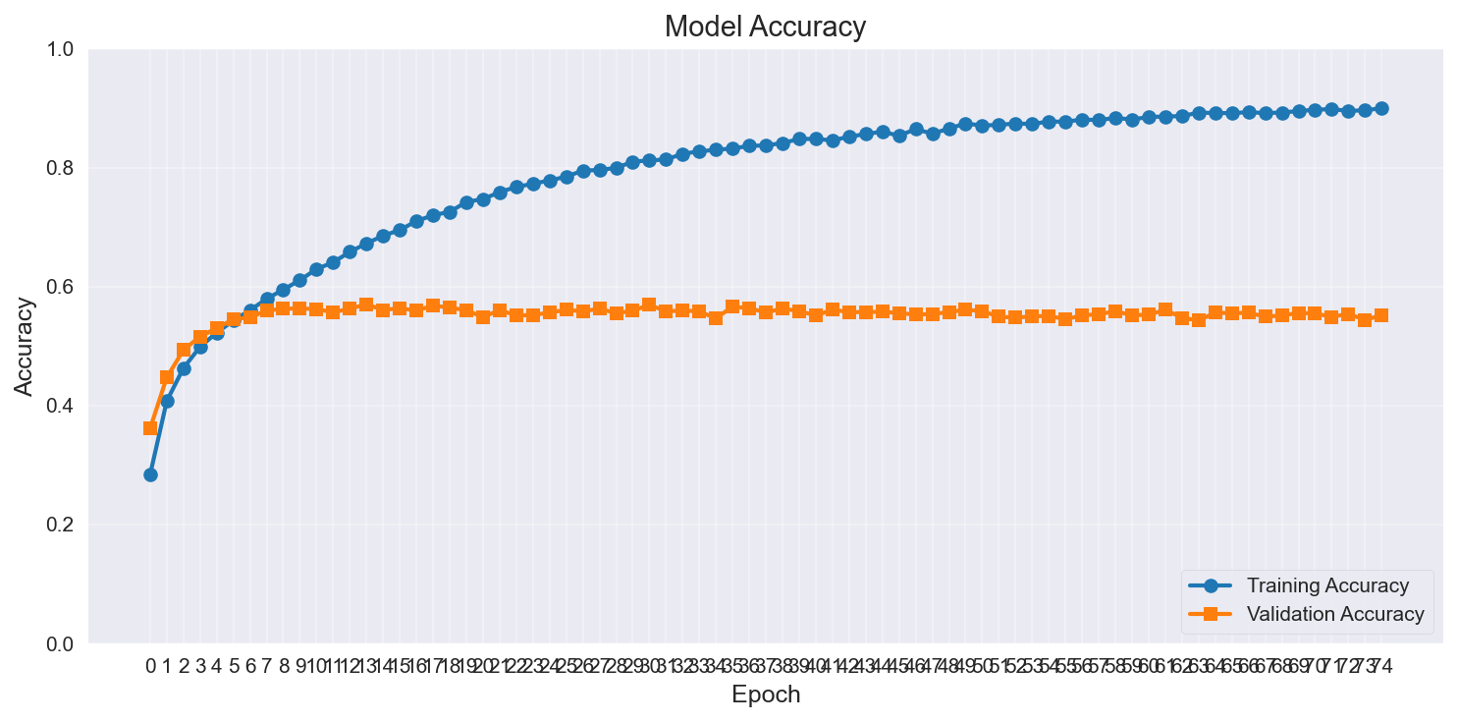

Slide 22
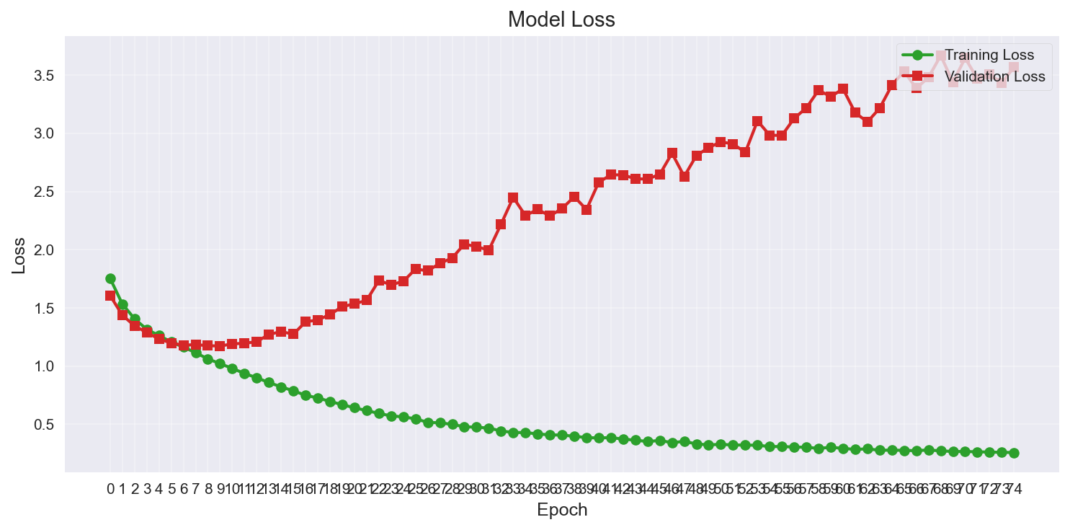
113/113 [==============================] - 4s 33ms/step - loss: 3.3912 - accuracy: 0.5626 Test Accuracy: 56.26%

Slide 23
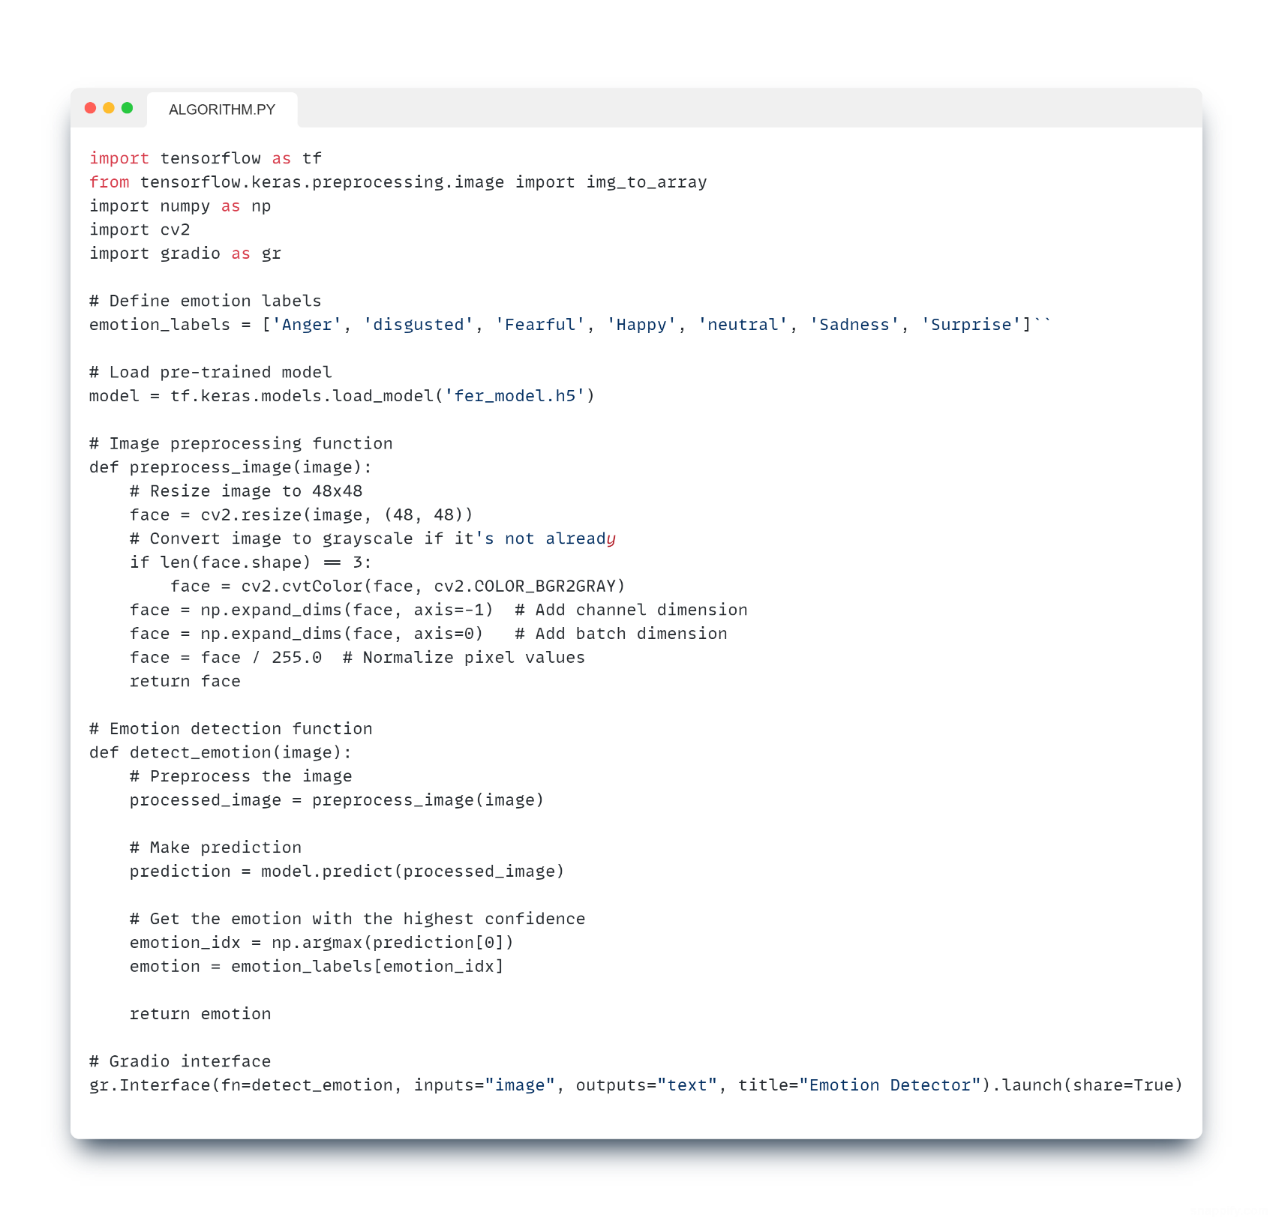
CODE

Slide 24
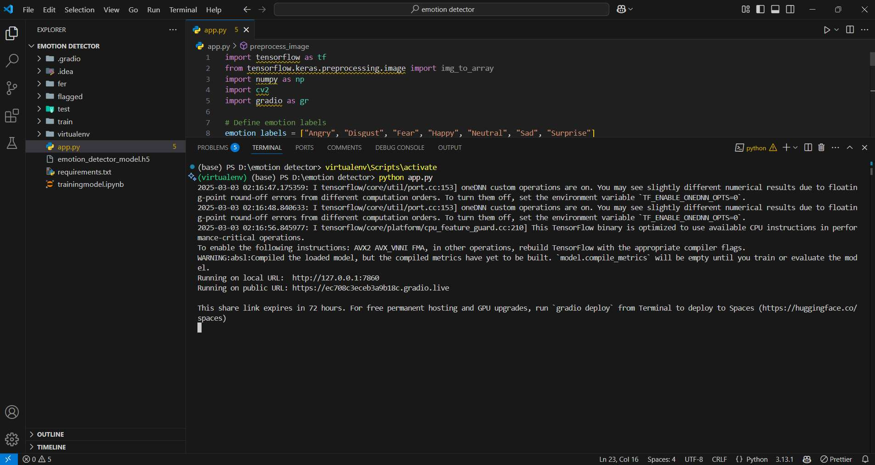
Output:
We use “python App.py ” to make run the server
IT WILL GENRATE A LINK

Slide 25
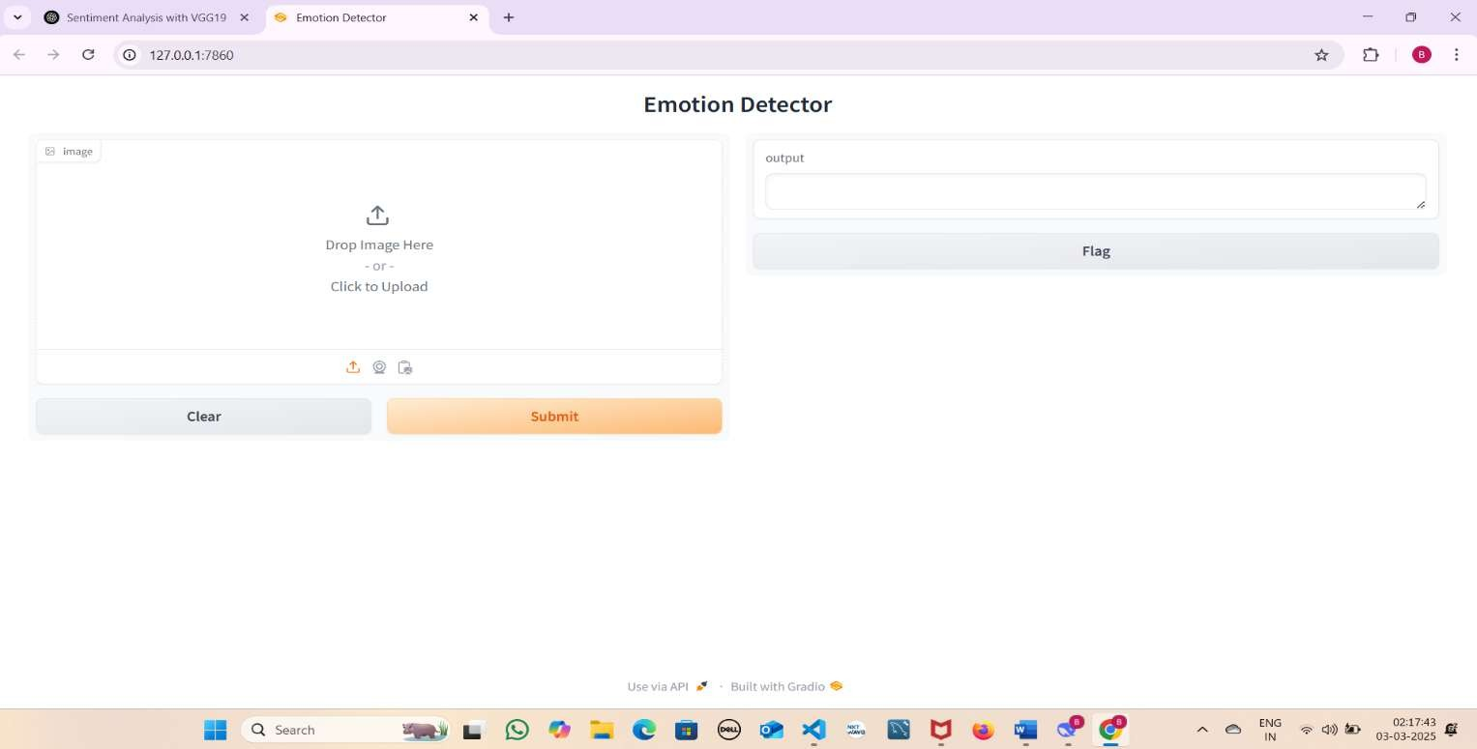
After clicking the link it will redirect to this page , This is the interface of the web page

Slide 26
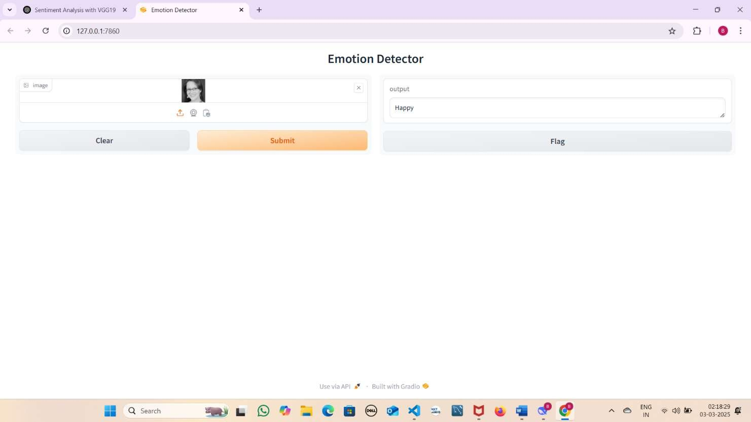
After Selecting the image from computer then click on submit button it show emotion of the image in the output box

Slide 27
Conclusion
The developed emotion recognition system, leveraging the VGG19 architecture and FER-2013 dataset, achieved a final accuracy of 65%, demonstrating promising performance given the inherent challenges of facial expression analysis. While this accuracy may appear modest at first glance, it represents a significant milestone in balancing model complexity with real-world applicability. The system’s performance aligns with established benchmarks for the FER-2013 dataset, where state-of-the-art models typically achieve 65–75% accuracy due to the dataset’s limitations, including low-resolution images (48×48 pixels), subtle inter-class variations (e.g., distinguishing fear from surprise), and significant class imbalances (e.g., limited disgust samples).

Slide 28
FUTURE ENHANCEMENT
Advanced Architectures: o Replace VGG19 with lightweight, state-of-the-art models like Efficient Net, Vision Transformers (ViT), or hybrid CNN-Transformer architectures to improve accuracy while reducing computational costs. o Implement attention mechanisms to focus on critical facial regions (e.g., eyes, mouth) for fine-grained emotion analysis.
Data-Centric Improvements: o Integrate high-resolution datasets (e.g., Affect Net, Celeb A) to address FER2013’s low resolution limitations. o Use synthetic data generation (e.g., GANs, diffusion models) to balance underrepresented classes like disgust. o Adopt contrastive learning or self-supervised pretraining to learn robust facial representations.
Multimodal Fusion: o Combine facial analysis with speech tone, body language, or text sentiment (e.g., from user inputs) for context-aware emotion detection. o Explore temporal modeling (e.g., LSTMs, 3D CNNs) to analyze emotion dynamics in video sequence

Slide 29
REFERENCES
[1] Wu, L., Qi, M., Jian, M., & Zhang, H. (2020). Visual sentiment analysis by combining global and local information. Neural Processing Letters, 51(3), 2063-2075.
[2] Chaturvedi, I., Cambria, E., Welsch, R. E., & Herrera, F. (2018). Distinguishing between facts and opinions for sentiment analysis: Survey and challenges. Information Fusion, 44, 65-77.
[3] Hofacker, C. F., Malthouse, E. C., & Sultan, F. (2016). Big data and consumer behavior: Imminent opportunities. Journal of consumer marketing.
[4] Liu, X. Q., Wu, Q. L., & Pan, W. T. (2019). Sentiment classification of micro‐blog comments based on Randomforest algorithm. Concurrency and Computation: Practice and Experience, 31(10), e4746.
[5] Taylor, W., Shah, S. A., Dashtipour, K., Zahid, A., Abbasi, Q. H., & Imran, M. A. (2020). An intelligent non-invasive real-time human activity recognition system for next-generation healthcare. Sensors, 20(9), 2653.
[6] Yang, L., Zhang, H., Li, D., Xiao, F., & Yang, S. (2021, September). Facial Expression Recognition Based on Transfer Learning and SVM. In Journal of Physics: Conference Series (Vol. 2025, No. 1, p. 012015). IOP Publishing.
[7] Simonyan, K., & Zisserman, A. (2014). Very deep convolutional networks for large-scale image recognition. arXiv preprint arXiv:1409.1556.

Slide 30
Thank you

